Slide 1
Bundled Pricing and Metered Pricing
Pricing Strategies
2025
Jean-Pierre Dubé
© Copyright 2025

Slide 2
Overview
Three pricing structures
Bundling to capture value
Mixed Bundling as product line pricing
Metered Pricing
The “Razors & blades problem”
Related to bundling complements
1
2
3

Slide 3

Bundling & Mixed Bundling

Slide 4


Price Bundling Bundling non-complements
Reporter
Analyst
WTP
WTP
$100
$100
$30
$20
Word
Perfect
Lotus 1-2-3
Word
Perfect
Lotus 1-2-3

Slide 5
Price Bundling Bundling non-complements
Can you derive demand for the Bundle?
Reporter
Analyst
WTP
WTP
$100
$100
$30
$20
Word
Perfect
Lotus 1-2-3
Word
Perfect
Lotus 1-2-3

Slide 6
Price Bundling Bundling non-complements
Suppose a monopolist sold both software titles as a bundle?
Reporter
Analyst
$30
$20
WTP
For
Bundle
Price bundling: no product integration
(i.e., no inter-dependencies/complementarities)
$100
$100

Slide 7
Price Bundling Bundling non-complements
Pure Components
Word Perfect: $100, give up Analysts
Lotus 1-2-3: $100, give up Reporters
Get $100 total from each customer
Untapped demand: $30 for Reporters, $20 for Analysts
Pure Bundling
Bundle: $120, sell both items to all customers
Only $10 left on table for reporters
i.e., Bundling to price-discriminate (capture more value)
Why?

Slide 8
Price Bundling Bundling non-complements
Compare Market Demands
Result:
Bundle demand is more elastic
(less dispersion in WTP)
Price
$130
Bundle demand
$100
$30
Lotus demand
$20
Word Perfect demand
Quantity (share)
50%
100%

Slide 9
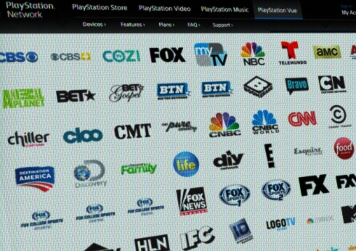
Price Bundling Bundling non-complements
Bundling can capture consumer value (i.e., price discriminate) if WTP for bundle more homogeneous than WTP for components
b/c tastes are negatively correlated
bundled demand is more price-elastic
Cable TV is canonical example for bundling
MTV & SoapNet taste correlation: -0.13
CNBC & Comedy Central taste correlation: -0.19
versus
ESPN & ESPN2 have taste correlation of 0.67
Source: Crawford and Yurukoglu (2011)
Notes:
Boundary Conditions: Chernev and Brough (2012): find that categorization can lower WTP for bundle when you combine an expensive item and a relatively inexpensive item. Consumer WTP for bundle can be LOWER than for expensive item alone.

Slide 10
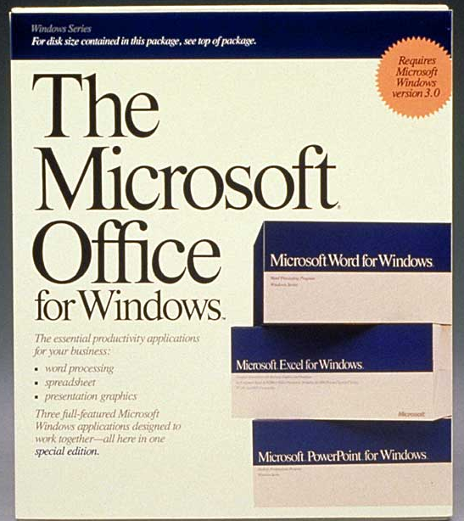
Price Bundling: competitive strategy Microsoft’s launch of MS Office in 1990
Office Bundle more appealing
Analysts indifferent
Reporters strictly prefer bundle
Microsoft’s bundle more profitable than incumbents’ combined profits.
In example, bundle profits=$240 vs component profits=$200.
See appendix for actual data!

Slide 11
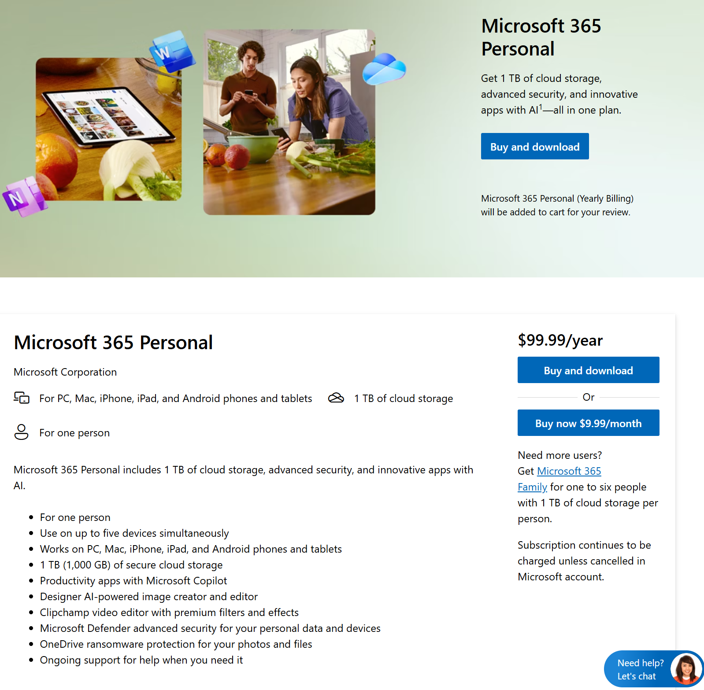
Microsoft still uses some Pure Bundling
Subscription bundle includes several applications that cannot be purchased as standalone items.
(e.g., cloud storage, cloud-connected features, AI features in apps …)
02/22/2025

Slide 12
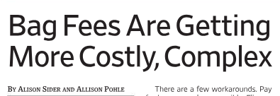
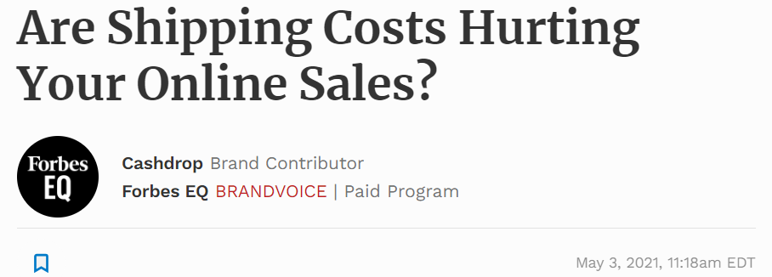

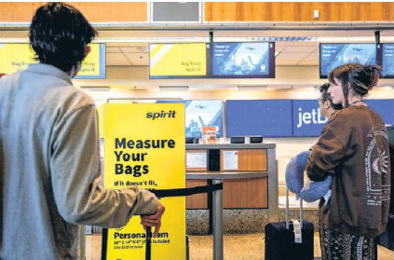
Bundling vs Unbundling
Free Shipping as bundling
Baggage fees as unbundling
Wall Street Journal, April 23, 2024
Unbundle?
Partitioning prices effective if consumers don’t pay attention to add-ons at point of sale (see Greenleaf et al 2016)
➔ But is this marketing for bad?
Notes:
Shipping → value vs cost. But baggage doesn’t seem like a cost to supply

Slide 13


Unbundling, Partitioned Prices & Salience Consumer Inattention (marketing for good?)
Consumers don’t consider/notice the “add-on” prices…
Demand falls when combine all fees into price
Sales tax inclusive prices in retail (Chetty et al 2009)
Fee-inclusive prices at stubhub.com (Blake et al 2020)
The Gap Between the Price You See and What You Pay Is Getting Worse
A mass unbundling of charges creates more surprise fees when it’s time to pay
Rachel Wolfe, WSJ, May 7, 2024

Slide 14


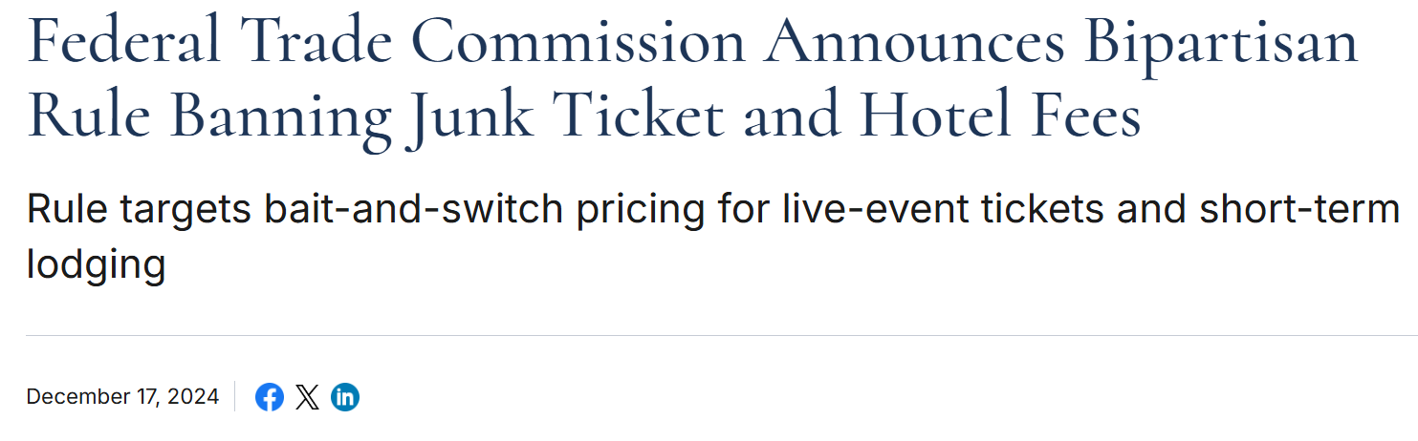
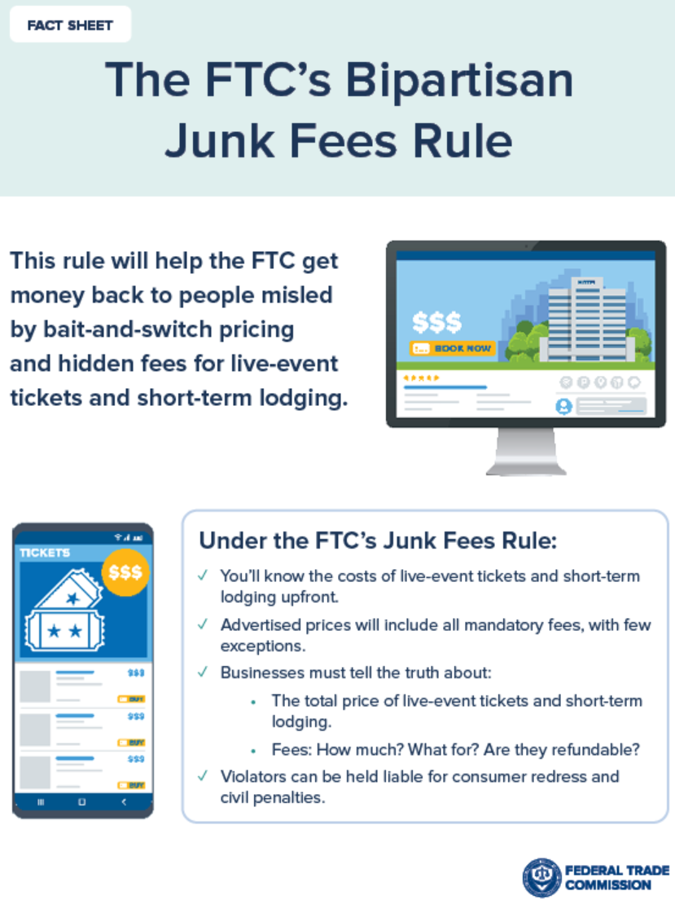
Public Policy & Regulation are catching on
New York to Ban Hidden Fees in Live-Event Ticketing
Anne Steele, WSJ, 6-7-2022
“It is seen as a rare win for consumers who, lawmakers say, have suffered from ticketing companies’ predatory pricing practices.”
All-in pricing (final price disclosed from start)
Re-sales require displaying original price
Airbnb results pages exclude charges & fees from displayed prices
Australian Competition & Consumer Commission (2015) and European Commission (2019)
“In accommodation searches with selected dates, users see the total price in the results page, including all the applicable mandatory charges and fees (such as service, cleaning charges and local taxes). There are now no surprise mandatory fees appearing on later pages.”
“…to prohibit bait-and-switch pricing and other tactics used to hide total prices and bury junk fees in the live-event ticketing and short-term lodging industries.”

Slide 15
Legality of hidden fees Hidden Ticket Fees
New York to Ban Hidden Fees in Live-Event Ticketing
Anne Steele, WSJ, 6-7-2022
“It is seen as a rare win for consumers who, lawmakers say, have suffered from ticketing companies’ predatory pricing practices.”
Mandates:
All-in pricing (final price disclosed from start)
Re-sales require displaying original price

Slide 16


Sustainability of Junk Fees Hotel Resort Fees
“Marriott and Hilton Sued Over ʻResort Fees,ʼ Long a Bane for Travelers”
8-23-2019, New York Times
Resort fees typically not disclosed with published room rates
$9-$95 per day at Marriott, $15-$45 per day at Hilton
Disclosure only after beginning checkout process
According to Consumer Reports (2023) :
1/3rd of US Adults charged “hidden” hotel fees in past 3 years
Hotel industry collected $2.9 Billion in resort fees in 2018
Bi-partisan bill H.R. 4489 to prohibit such deceptive price advertising
AG: Marriott Hotels to pay $225K in ‘hidden fee’ settlement
Vivian Muniz, Crime & Court, April 12, 2023

Slide 17
Mixed Bundling
Sell Bundle along with the Individual Components
Analogous to Product Line Pricing
E.g., Office Bundle vs. Word, Excel, etc. à la carte
Similar Trade-offs
Add pure components to acquire new customers
But adding pure components may cannibalize bundle

Slide 18
Mixed Bundling and non-complements
Word
Excel
Reporter
Analyst
Engineer
This is our original scenario
Product | Price | Demand
Word + Excel | $120 | Reporter + Analyst
Excel Only | $105 | Engineer
Revenue | $345
Now suppose we have another segment
$30
$20
$5
WTP
For
Bundle
$105
$100
$100

Slide 19
Mixed Bundling and non-complements
Word
Excel
Reporter
Analyst
Engineer
Product | Price | Demand
Word + Excel | $110 | Reporter + Analyst
Excel Only | $ 90 | Engineer
Revenue | $310
Product | Price | Demand
Word + Excel | $120 | Reporter
Excel Only | $ 90 | Engineer + Analyst
Revenue | $300
What if the engineer valued Excel less?
$30
$20
cannibalization
WTP
For
Bundle
$5
$100
$100
$90
Engineer profits are incremental. But we can do better.

Slide 20
Mixed Bundling and non-complements
Word
Excel
Reporter
Analyst
Engineer
Product | Price | Demand
Word + Excel | $120 | Reporter + Analyst
Revenue | $240
Product | Price | Demand
Word + Excel | $120 | Reporter
Excel Only | $ 50 | Engineer + Analyst
Revenue | $220
What if the engineer valued Excel even less?
$30
$20
cannibalization
WTP
For
Bundle
$100
$100
Does it really make sense to sell Excel unbundled?
$5
$50

Slide 21
Mixed Bundling and non-complements
Mixed Bundling is just segmentation with a Product Line.
As before, coordination is crucial to avoid cannibalization.
use individual components (unbundled) for new demand in segments that would not buy the bundle.
E.g., sell MS Word à la carte for students.
But, be sure to coordinate the potential cannibalization.
See Appendix for discussion of data analytics and bundling

Slide 22



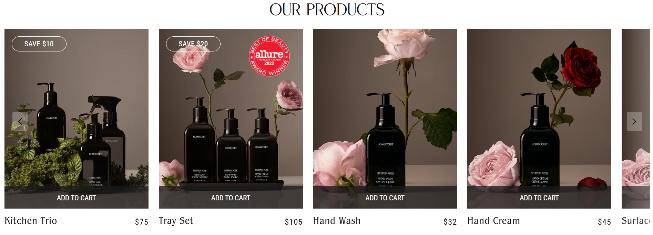
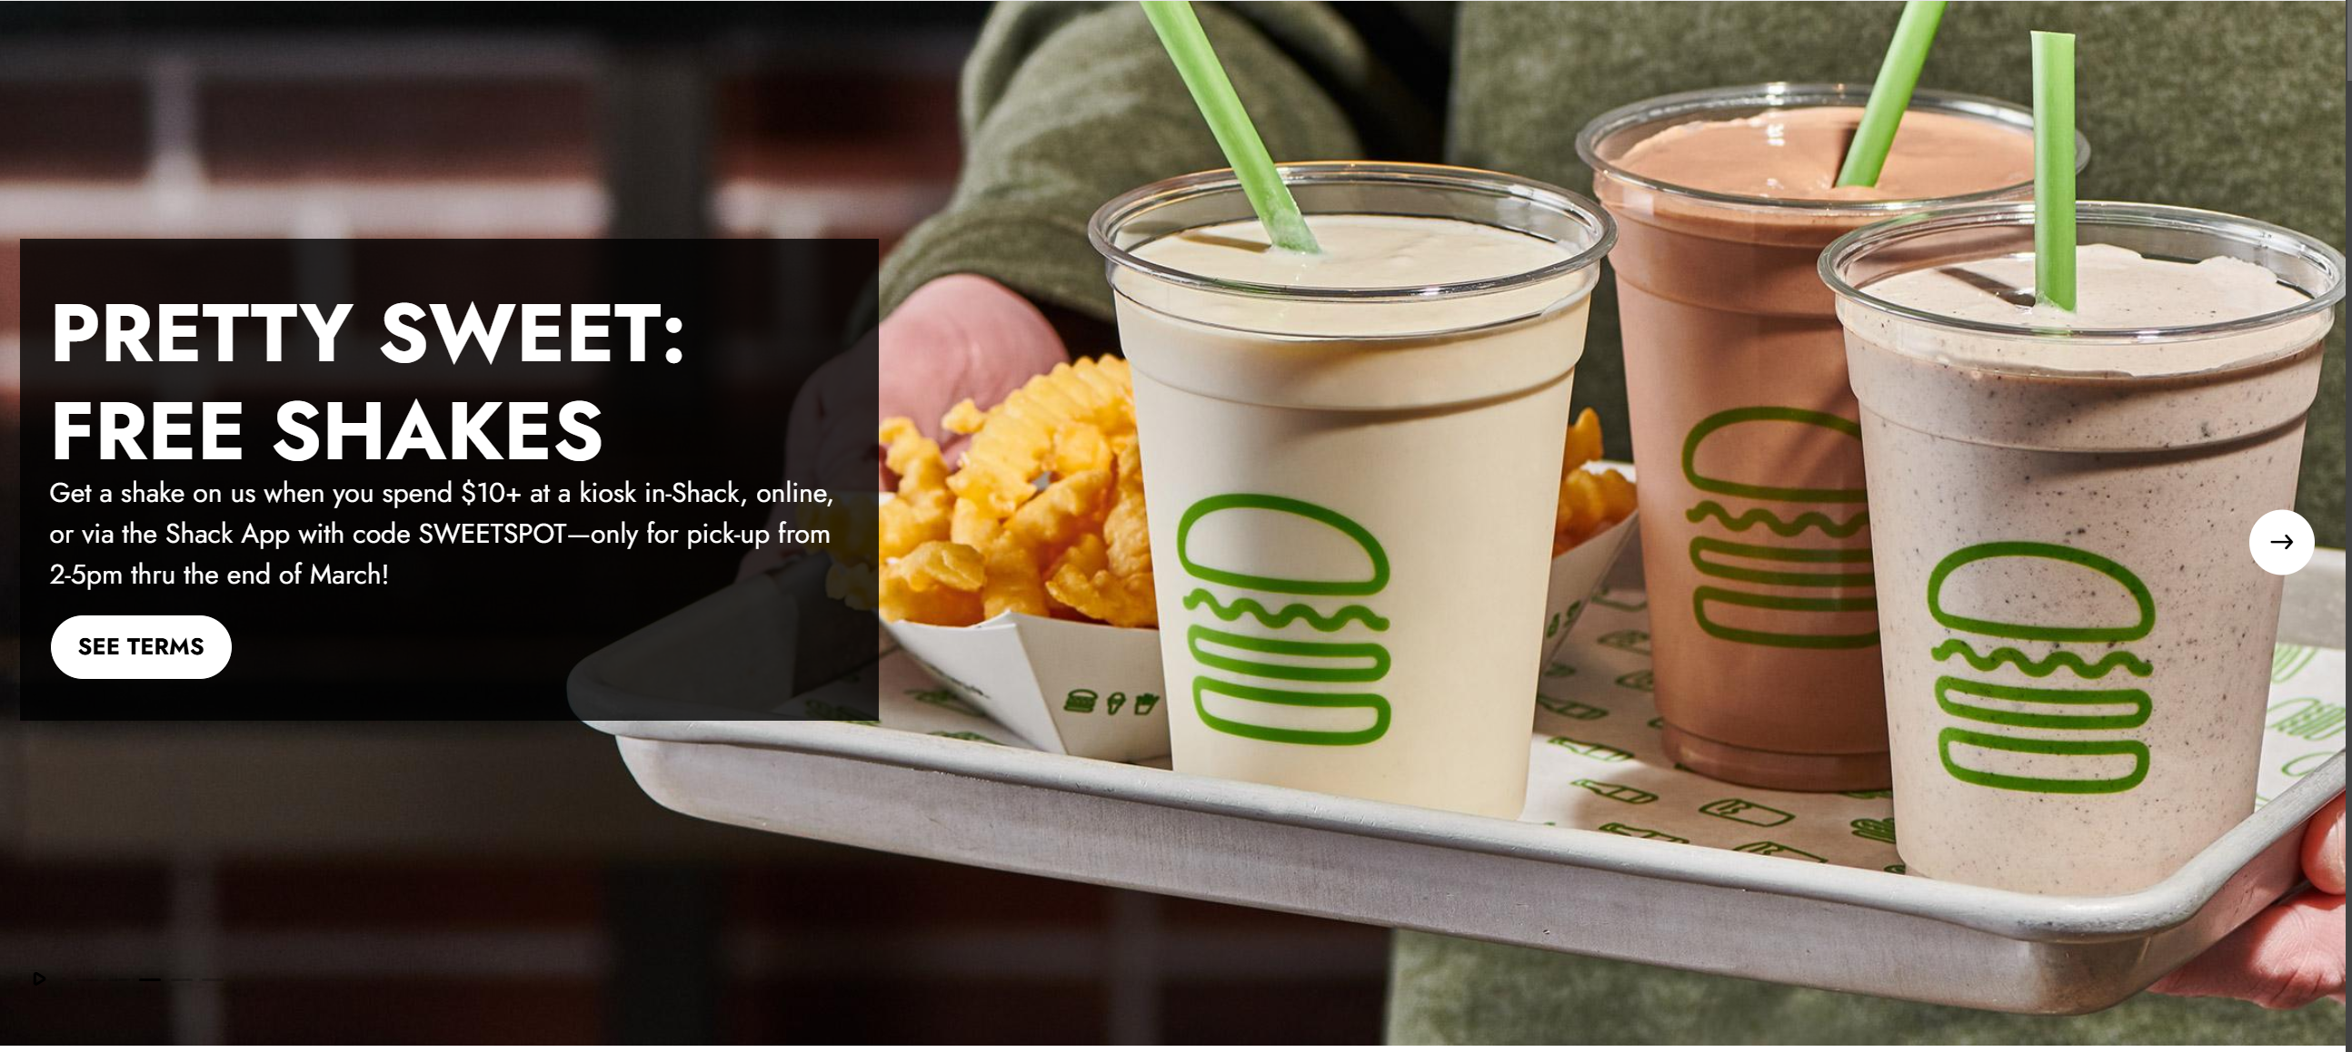


Mixed Bundling (Tactics & Strategy)
Can buy individual products. But bundle has a discount.
Incentivizes up-trade to full meal to hit BOGO threshold.
Can use mixed bundling to clear out excess inventory by bundling slow-moving items.

Slide 23
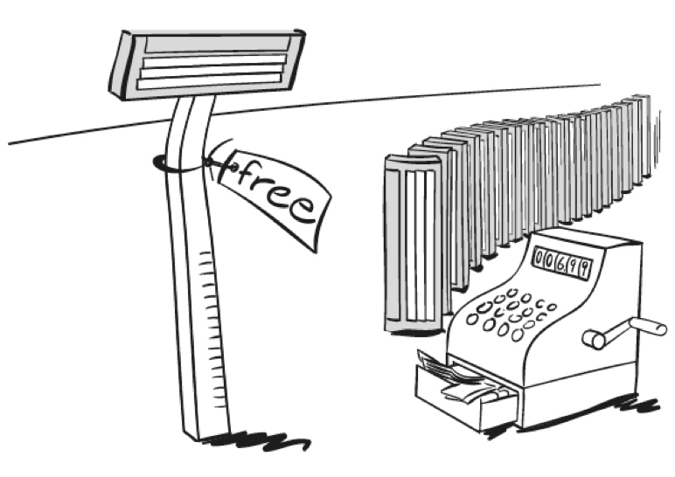
Metered Pricing

Slide 24
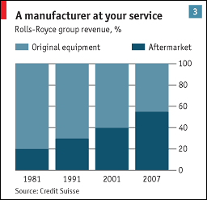
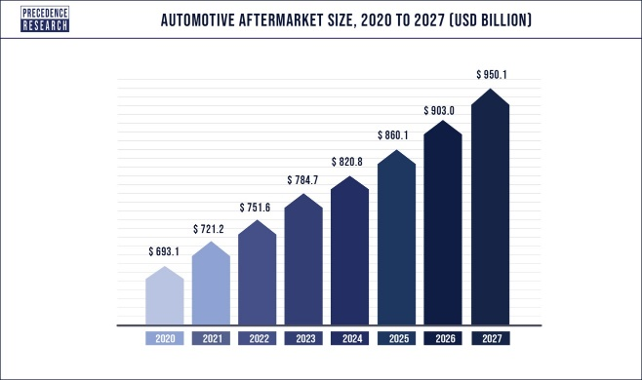
Metered Pricing: The Razor & Blades Model
Also known as “bait-and-hook” pricing
Examples:
Gillette Mach 3 Razor $7.69, 12 blades (3-month supply) $21.99
Inkjet printers under $200, HP replacement cartridge $52
Jet engines cheap (Rolls Royce, GE…), high mark-ups on
aftermarket maintenance and replacement parts
Automobile aftermarket also growing fast!!!
Economist, Jan. 8, 2009
Globenewswire, Jan. 3, 2022

Slide 25
Metered Pricing Theory
Two complementary goods
One with fixed-quantity demand
One with variable-quantity demand
Loss-leader pricing on the fixed-quantity product, then Price-discriminate on variable-quantity product
Particularly effective if variable-quantity demand good is a commodity (i.e., hard to profit on it as a stand-alone business)

Slide 26
Metered Pricing Theory Example: Printers & Ink
Suppose you are selling printers and ink cartridges
No competition on printers
high competition on ink (i.e., no differentiation value for ink)
i.e., stand-alone ink profits close to zero
Marginal Costs: $80 (printer), $1.5 (ink cartridge)
Consumer Type | Valuation Per Unit
 | Fixed-Quantity Good | Variable Quantity Good
 |  | 1 | 2 | 3 | 4 | 5
1 | $210 | $16 | $14 | $10 | $5 | 0
2 | $140 | $14 | $12 | $7 | 0

Slide 27

Profits and Razor & blades theory Scenario 1 : Printers & ink operated independently
Profits only from printers b/c competitive ink market.
If you charge $210 for printer
Sell only to high WTP customers
Total profits: $130
If you charge $140 for printer
Sell to both high and low WTP customers
Total profits: $120
Profit = $\left(\$210−\$80\right)×1=\$130$
Consumer Type | Valuation Per Unit
 | Fixed-Quantity Good | Variable Quantity Good
 |  | 1 | 2 | 3 | 4 | 5
1 | $210 | $16 | $14 | $10 | $5 | 0
2 | $140 | $14 | $12 | $7 | 0

Slide 28
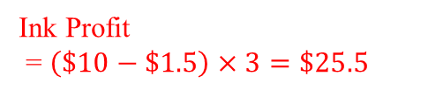
Profits and Razor & blades theory Scenario 2: Printers & ink tied together
Tie ink cartridges to printer to lock-in ink sales via printer sales
If you charge $210 for printer
Only sell to high WTP customers
Optimal price for cartridges is $10
Total profits: $130 + $25.5 = $155.5
If you charge $140 for printer
Sell to both high and low WTP customers
Optimal price for cartridges is $10
Total profits: $120 + $42.50 = $162.50
Ink Profit
= $\left(\$10−\$1.5\right)×3=\$25.5$
Consumer Type | Valuation Per Unit
 | Fixed-Quantity Good | Variable Quantity Good
 |  | 1 | 2 | 3 | 4 | 5
1 | $210 | $16 | $14 | $10 | $5 | 0
2 | $140 | $14 | $12 | $7 | 0

Slide 29
Profits and Razor & blades theory
Tying causes firm to cut the printer’s price to extract more value from the consumer on the ink
loss-leader pricing to leverage monopoly on base good
Price segmentation: Consumer segment with high WTP for printer also buys more ink and spends more!
Consumer Type | Valuation Per Unit
 | Fixed-Quantity Good | Variable Quantity Good
 |  | 1 | 2 | 3 | 4 | 5
1 | $210 | $16 | $14 | $10 | $5 | 0
2 | $140 | $14 | $12 | $7 | 0
Exercise: See if you can re-do scenario 2 with an even more profitable volume discount on the variable-quantity good.

Slide 30



Cloud Computing and Metering?
Heavy investment in cloud services (Q1 2015):
Amazon: $871 mill
Microsoft: $1.4 bill
Google: $2.93 bill
“Silver Linings in Big Cloud Spending,” WSJ, 4-27-2015
Cloud storage seems commoditized
But …
Charge each time data accessed/processed
Data management services
“Rent” software in cloud (SaaS)
Sustainable Growth?
…another notable slowdown in growth for their respective cloud-
computing services following a weak December quarter as large
companies continue to scrutinize their spending on technology…
all three have soundly outperformed the S&P 500…
another key facet is hype over generative artificial intelligence
technology that all three are incorporating into their services…
“Big Tech Depends on AI Shining Through Cloud Haze” WSJ, April 23, 2023
Microsoft Cloud Business generated $137.4 Billion in 2024 (up 20%)
Microsoft Annual Report, 2024
"Our early investments in the intelligent cloud and intelligent edge are paying off”
Satya Nadella, MS CEO, class of ‘97
Microsoft profit climbs as cloud grows
Glenn Chapman, Phys.org, 7-20-2018

Slide 31

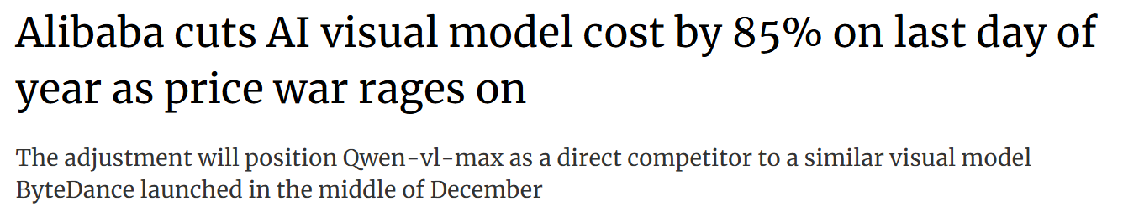


B2B Metered Pricing Cloud Computing
Price War?
Or
Razors & Blades?!
Similar story playing out in China
Q3 2024 cloud infrastructure service spending reached US$10.2 billion (11% growth)
“…Alibaba Cloud's price cuts underscore its commitment to fueling the adoption of AI technologies...”

Slide 32

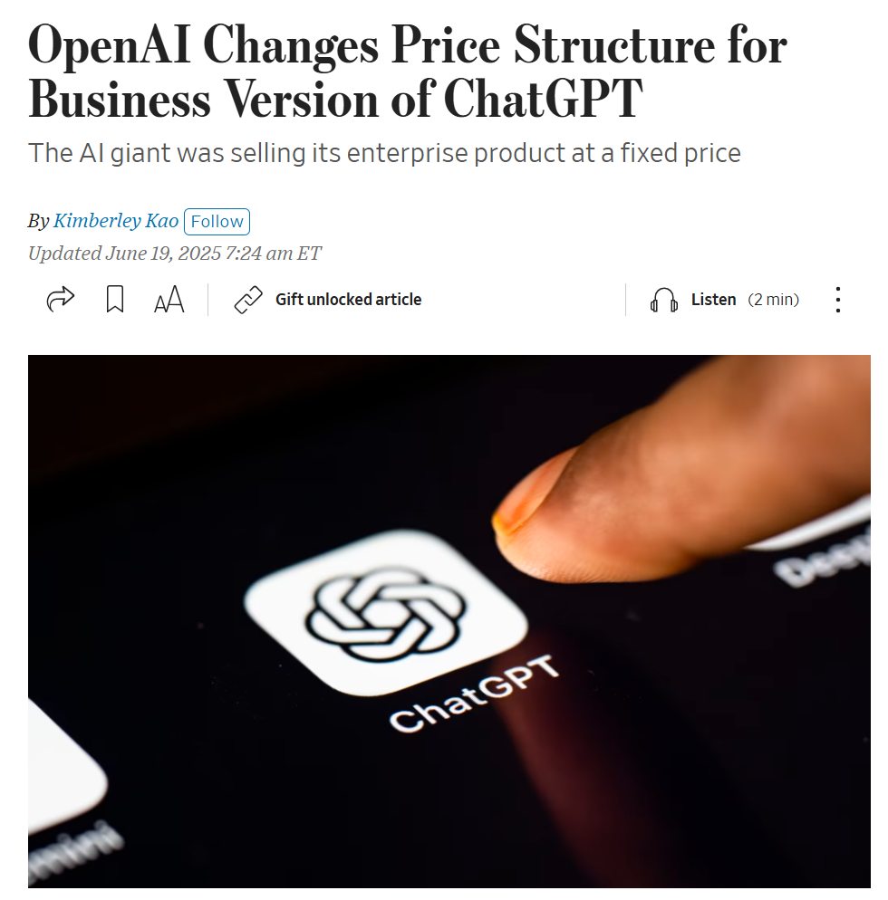
B2B Metered Pricing AI
Previously ChatGPT Enterprise used fixed prices (subscription)
Now launching credit system so clients can upgrade to advanced features
Price of ChatGPT Enterprise will depend on number of credits
Sound familiar?
Menu of Two-part tariffs?

Slide 33
Metering over time Vapes & Marketing For Bad
Cheap/Free initial vape induces Trial & Repeat
(US & UK)
Replacement cartridges 4 times more expensive than combustible cigarettes
Source: Tattan-Birch et al (2021), “Give ‘em the vape, sell ‘em the pods’: razor-and-blades methods of pod e-cigarette pricing,” Tobacco Control

Slide 34
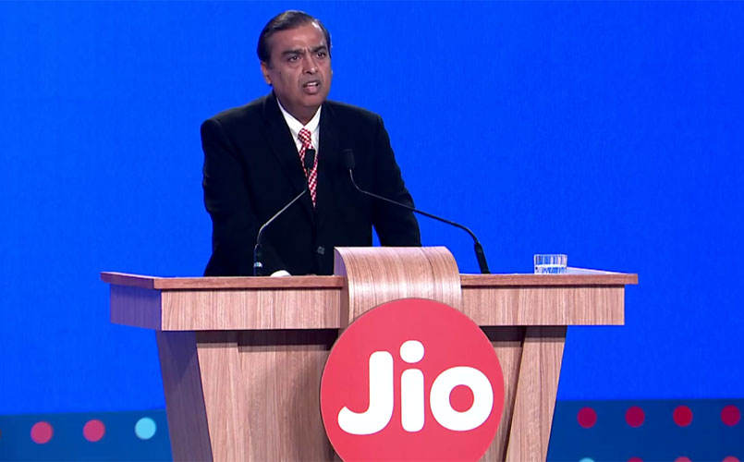
Metering over time Wi-fi in India & Marketing For Good
Two Years Ago, India Lacked Fast, Cheap Internet—One Billionaire Changed All That
Mukesh Ambani’s national 4G network for Reliance Jio, which charges pennies for data, is bringing hundreds of millions online for the first time
WSJ, 5-5-2018
Free calls
Data for pennies
Opens market to 1.3 billion people
Company’s plan:
“use the platform to sell content, financial services and advertising.”
488 million active users!
₹206 ARPU (about $2.4 USD)
➔18.5% EBITDA growth
Business Today, 04-24-2026
“Reliance Jio will move India from data shortage to data abundance.”
Mukesh Ambani
Reliance JIO
Glenn Chapman, Phys.org, 7-20-2018

Slide 35
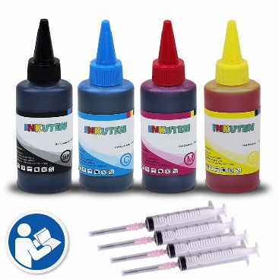
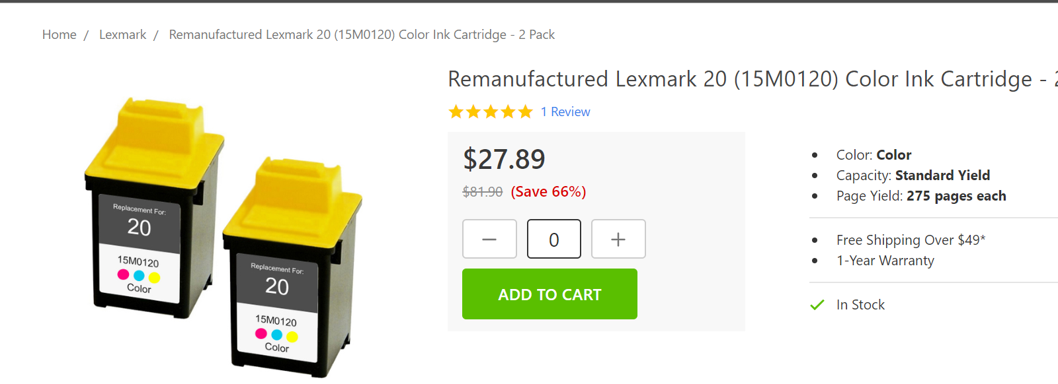
Threats to Metered Pricing
Release of Compatible Generics into secondary ink market
Staples has generic ink cartridges for 25% less
Inkjet refill kits $15
Resale of refurbished (i.e., refilled) ink cartridges
Lexmark blocked re-fill kits with sensor
Lexmark recently fought to prevent resale of used cartridges
See: Lexmark International, Inc. v. Static Control Components, Inc
Notes:
Nelson Peltz fought (and lost) to get a seat on P&G’s board, arguing P&G was not innovating enough.

Slide 36
Threats to Metered Pricing
Antitrust Concerns: illegal to block entry into your aftermarket!
Legality of Tying (protection of intellectual property versus foreclosure of rivals)
Some famous cases:
Microsoft
Lexmark
iTunes and iPod in Europe (interoperability)

Slide 37
Take Away
Bundling & Metering as price discrimination (capture value)
These are Product Line Pricing Strategies
Mixed Bundling and substitutes
Metering and complements (leads to loss-leading on the “bait” product)
Coordination of Price and Product again…
Legality of Metering can be tricky
Illegal as means to foreclose competition
The Economics of inattention raises new ethical/legal considerations

Slide 38
Microsoft Office Software

Slide 39
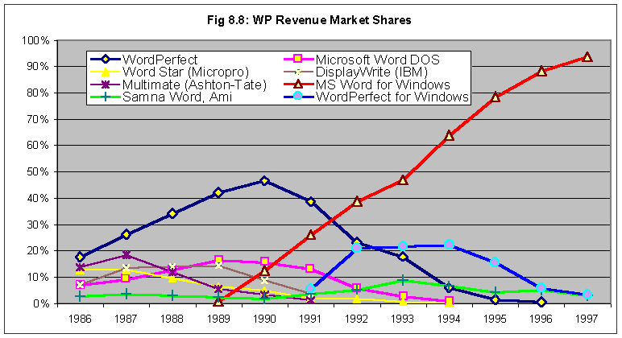
MS Word take-off in the U.S.
MS Office launch in 1990

Slide 40
More examples

Slide 41
Investing in Retention
AT&T, Verizon Push Free iPhones for Long-Term Customers
WSJ, June 5, 2021
Subsidized phones for trade-ins from new & existing subscribers
New iPhone subsidies on $1,000 price: from free to $700 rebate
AT&T cost: $2 billion /quarter
AT&T service revenues: $47 ARPU/month
AT&T added 1.4 million post-paid connections (Oct ’20 –March’21)
AT&T: free iPhone 12
Verizon response
Notes:
Note: AT&T growth at end of 2020

Slide 42
Extra
Data analytics and Bundling

Slide 43
Data analytics and bundling
Let’s consider the data analytics associated with bundling
What would we need to observe in our marketing research to suggest a motive for bundling non-complements?
Suppose you have conducted a conjoint analysis and estimated consumer valuations (WTP) for your components…

Slide 44
Data
Valuation
of
Product 2
v₂
WTP estimates for different subjects
v₁
Valuation
of
Product 1

Slide 45
Pure Components Strategy
Valuation
of
Product 2
v₂
B
A
Buy Item 2
Buy Both
p₂
C
D
Buy None
Buy Item 1
v₁
p₁
Valuation
of
Product 1

Slide 46
Pure Bundling Strategy
Valuation
of
Product 2
If bundle was 4 units of product 2 and
1 unit of product 1, then:
4v₂ + v₁ = p_{b} → v₂ = p_{b}/4 - v₁/4
v₂
p_{b}
E
Buy Bundle
p_{b}/4
F
v₂ = p_{b} – v₁
Buy None
Valuation
of
Product 1
p_{b}
v₁

Slide 47
Bundle or Items?
Valuation
Of
Product 2
v₂
Negative Correlation
In Values, so Bundle
p_{b}
Valuation
Of
Product 1
p_{b}
v₁

Slide 48
Bundle or Items?
Valuation
Of
Product 2
v₂
No advantage to Bundle
over pure components
p₂
Valuation
Of
Product 1
p₁
v₁

Slide 49
Mixed Bundling Strategy
Valuation
of
Product 2
v₂
Only 2
Both
None
Only 1
Valuation
of
Product 1
v₁

Slide 50
Mixed Bundling Tactics Lower item 1 price from p₁ to p*
Valuation
of
Product 2
v₂
“Dilution”
(shift from bundle to item)
“Stimulation”
Valuation
of
Product 1
p*
v₁

